Slide 1
SS ZG653: Software Architecture Lecture 9: Review Session
Instructor: Prof. Santonu Sarkar
February 11, 2015

Slide 2
Review Intro to SW Architecture

Slide 3
Software Architecture Definition
No unique definition though similar…
(look at http://www.sei.cmu.edu/architecture/start/glossary/classicdefs.cfm )
Is a high level design
Is the overall structure of the system
Is the structure of the components of a program or system, their interrelationships, and the principles and guidelines governing their design and evolution over time

Slide 4
Architecture Styles
Architecture style– synonymous to “architecture pattern”
A set of element types (data store, compute linear regression function)
A set of interaction types (function call, publish-subscribe)
Topology indicating interactions and interaction types
Constraints
Reference model
Decomposes the functionality into a set of smaller units
How they interact and share data
Reference architecture of a reference model
Concrete software elements, mapped to the units of the reference model, that implement the functionality
X
Reference Model
X
√
Reference Architecture
Software Architecture
Architectural Pattern
X

Slide 5
Views and Architectural Structure
It is too complex to describe, understand and analyze the architecture using one common vocabulary for all stakeholders
View based approach
Each view represents certain architectural aspects of the system, created for a stakeholder
A Structure is the underlying part of a view- essentially the set of elements, and their properties
Module Structure
How is the system to be structured as a set of code units (modules)?
Component-and-connector structures
Set of elements that describe runtime behavior (components) and interactions (connectors)
Allocation structures
How is the system to relate to non-software structures in it’s environment (CPU or cluster of CPUs, File Systems, Networks, Development Teams …)

Slide 6
Benefits of Software Architecture
Every stakeholder should understand “unambiguously” what the blueprint is
Streamlining work assignments for multiple teams
Design decisions are made early
Improve speed of development

Slide 7
Modular Structures
Module Structure includes
Decomposition
Sub-modules
All sub-mobiles combined together is the module
Uses
A modules uses the functionality of another module for its behavior
Layered
Hierarchical organization with restrictions that layer n uses the service of layer n-1
Class or generalization
Similar to OO concept
Module
Decomposition
Class
Uses
Layered

Slide 8
Component and Connectors
Components-and-connector
Client-Server
Concurrency
Process
Shared data
Client-Server
Components are clients and servers and connectors are how they interact
Concurrency
Opportunities of parallelism, where connectors are logical thread of execution dependency
Process, or communicating processes
Components that are processes and connectors are how they communicate
Shared data, or repository
Components have data store, and connectors describe how data is created, stored, retrieved

Slide 9
Allocation Structure
Allocation
Deployment
Implementation
Work assignment
Deployment
Units are software (processes from component-connector) and hardware processors
Relation means how a software is allocated or migrated to a hardware
Implementation
Units are modules (from module view) and connectors denote how they are mapped to files, folders
Work assignment
Assigns responsibility for implementing and integrating the modules to people or team

Slide 10
Three Quality Classes
System Quality
Availability
Modifiability
Business Quality
Time to market
Cost and benefit
Quality of Architecture
Conceptual Integrity
Buildability
Performance
Security
Usability
Testability
Project lifetime
Targeted market
Rollout schedule
Legacy integration
Correctness
completeness
We will consider these attributes
We will use “Quality Attribute Scenarios” to characterize them
which is a quality attribute specific requirement

Slide 11
Architectural Tactics
To achieve a quality one needs to take a design decision- called Tactic
Collection of such tactics is architectural strategy
A pattern can be a collection of tactics
Condition that need to be considered
Environment
User, another software
Tactics are implemented to achieve the desired response
Measure or metric
that indicates the impact
Stimulus
Response

Slide 12
Review Quality Attributes

Slide 13
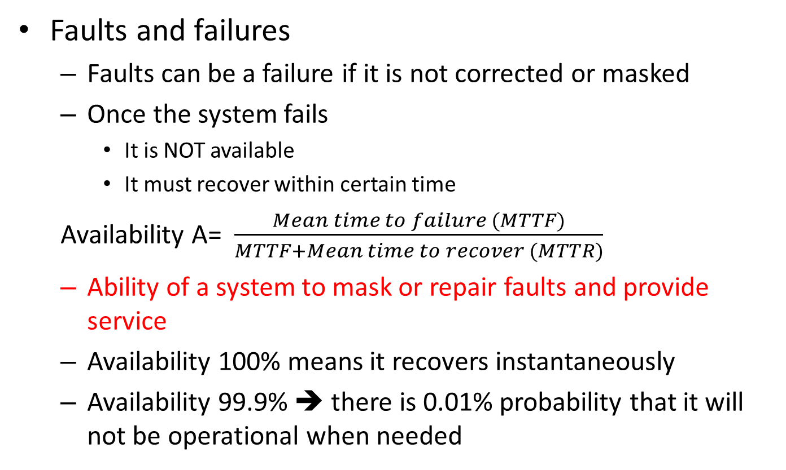
Availability
Faults and failures
Faults can be a failure if it is not corrected or masked
Once the system fails
It is NOT available
It must recover within certain time
Availability A= $\frac{Mean time to failure (MTTF)}{MTTF+Mean time to recover (MTTR)}$
Ability of a system to mask or repair faults and provide service
Availability 100% means it recovers instantaneously
Availability 99.9% ➔ there is 0.01% probability that it will not be operational when needed

Slide 14
Availability Tactics
Availability
Fault detection
Shadow operation
Failure prevention
Removal of a component to prevent anticipated failure– auto/manual reboot
Recovery by repair
Recovery by reintroduction
Create transaction
Process monitor- that can detect, remove and restart faulty process
State resynchronization
Checkpointing and rollback
Voting
Active redundancy
Passive redundancy
Spare copy
Ping/echo
Heartbeat
Exception

Slide 15
Modifiability
Ability to Modify the system based on the change in requirement so that
the time and cost to implement is optimal
Impact of modification such as testing, deployment, and change management is minimal

Slide 16
Modifiability Tactics
Modifiabilty
Localize change
Runtime registration
Prevent Ripple effect
Defer binding
Configuration files
Polymorphism
Hide Information
Maintain Existing Interface
Restrict Communication Paths
Use intermediary between modules
Factoring common service
Anticipate change
Generalize module
Limit possible options
Component replacement
Adherence to defined protocols

Slide 17
Localize Modifications
Factoring common service
Common services through a specialized module (only implementing module should be impacted)
Heavily used in application framework and middleware
Reduce Coupling and increase cohesion
Anticipate Expected Changes
Quite difficult to anticipate, hence should be coupled with previous one
Allow extension points to accommodate changes
Generalize the Module
Allowing it to perform broader range of functions
Externalize configuration parameters (could be described in a language like XML)
The module reconfigure itself based on the configurable parameters
Externalize business rules
Limit Possible options
Do not keep too many options for modules that are part of the framework
Module B
Calls/
Depends on
Module A

Slide 18
Dependency between two modules (B→ A)
Syntax (compile+runtime)
Data : B uses the type/format of the data created by A
Service B uses the API signature provided by A
Service: Same …..
Sequence
Data -- data packets created by A should maintain the order as understood by B
Control– A must execute 5ms before B. Or an API of A can be called only after calling another API
Interface identity
Location of A
Quality of service/data provided by A
Existence of A
Resource behavior of A
Semantics of A
Data: Semantics of data created by A should be consistent with the assumption made by B
Handle of A must be consistent with B, if A maintains multiple interfaces
B may assume that A is in-process or in a different process, hardware..
Data quality produced by A must be > some accuracy for B to work
B may assume that A must exist when B is calling A
B may assume that both use same memory
B needs to reserve a resource owned by A

Slide 19
Prevent Ripple Effect Tactics
Hide Information (of A)
Use interfaces, allow published API based calls only
Maintain existing Interface (of A)
Add new interfaces if needed
Use Wrapper, adapter to maintain same interface
Use stub
Restrict Communication Paths
Too many modules should not depend on A
Use an intermediary between B and A
Data
Repository from which B can read data created by A (blackboard pattern)
Publish-subscribe (data flowing through a central hub)
MVC pattern
Service: Use of design patterns like bridge, mediator, strategy, proxy
Identity of A – Use broker pattern which deals with A’s identity
Location of A – Use naming service to discover A
Existence of A- Use factory pattern
Module B
Calls/
Depends on/
Uses
Module A

Slide 20
What is Performance?
Software system’s ability to meet timing requirements when it responds to an event
Events are
interrupts, messages, requests from users or other systems
clock events marking the passage of time
The system, or some element of the system, must respond to them in time

Slide 21
Performance Tactics
Performance
Control Resource Demand
Reduce resource reqd
Increase in compute efficiency
Reduce overhead
Reduce #of events
Manage event rate
Control sampling freq
Control resource usage
Bound execution time
Bound queue size
Resource Management
Increase concurrency
Maintain multiple copies of data/ computation
Increase Resource
Resource Arbitration
FIFO
Scheduling policy
Static
Dynamic priority
Fixed priority

Slide 22
Security
A measure of the system’s ability to resist unauthorized usage while still providing its services to legitimate users
Security comprises of
Confidentiality
Nobody except you should be able to access your information
Integrity
prevention of the unauthorized modification or deletion of information
Availability
prevention of the unauthorized withholding of information – e.g. DoS attack
Important aspects of Security
Non repudiation: You cannot deny ordering something from the Internet, or the merchant cannot disclaim getting your order.
Assurance:: Typically through authentication. E.g. if you get an email purporting to come from a bank, it is indeed from a bank.
Auditing:: System tracks activities so that it can be reconstructed later
Authorization:: Grants a user the privileges – E.g an online banking system authorizes a legitimate user to access his account.

Slide 23
Security Tactics
Security
Detect
Revoke access
Recover
Maintain Audit trail
Resist/ Prevent
React
Restore
Use availability tactics
Lock system
Alert actors
Identify actors
Authenticate and authorize actors
Limit access and exposure
Maintain data confidentiality
Intrusion detection
Detect service denial
Verify message integrity
Detect message delay
Change default setting

Slide 24
Testability
The ease with which software can be made to demonstrate its faults through testing
If a fault is present in a system, then we want it to fail during testing as quickly as possible.
At least 40% effort goes for testing
Done by developers, testers, and verifiers (tools)
Specialized software for testing
Test harness
Simple playback capability
Specialized testing chamber
Architect’s aim is to reduce the high cost of testing when the software is modified

Slide 25
Testability Tactics
Testability
Manage controllability and Observability
Limit Structural complexity
Internal Monitoring
Manage Complexity
Limit non-determinism
Introduce built-in monitor in the system
Record and playback
Specialized Interface
Separate interface and implementation
Executable assertion
Localize data store
Sandbox

Slide 26
Usability
How easy it is for the user to accomplish a desired task and user support the system provides
Learnability: what does the system do to make a user familiar
Operability:
Minimizing the impact of user errors
Adopting to user needs
Giving confidence to the user that the correct action is being taken?

Slide 27
Usability Tactics
Usability is essentially Human Computer Interaction. Runtime Tactics are
User initiative (and system responds)
Cancel, undo, aggregation, store partial result
System initiative
Task model: understands the context of the task user is trying and provide assistance
Correct spelling during typing but not during password entry
User model: understands who the user is and takes action
Adjust scrolling speed, user specific customization, locale specific adjustment
System model: gets the current state of the system and responds
Time needed to complete a task

Slide 28
Interoperability
Ability that two systems can usefully exchange information through an interface
Ability to transfer data and interpret data
Information exchange can be direct or indirect
Interface
Beyond API
Need to have a set of assumptions you can safely make about the entity exposing the API
Example- you want to integrate with Google Maps

Slide 29
Tactics
Interoperability
Locate (Discover service)
Identify the service through a known directory service. Here service implies a set of capabilities available through an interface
By name, location or other attributes
Manage interface
Orchestrate
Co-ordinate and manage a sequence of services. Example- workflow, which can be expressed in BPEL language
Tailor interface
Add or remove capability from an interface (hide a particular function from an untrusted user)
Use Decorator pattern for this purpose

Slide 30
Review OO Programming and Pattern

Slide 31
Object and Class
Everything is an Object!
Structure -- Data
Means these are stored in memory and
Is made of other objects
Behavior--- Operations performed on this data
Every object has a type--- called class
All objects of the same type can receive the same messages.
Properties/Attribute values at a particular moment during runtime is the object state
Class represents an abstract, user-defined type
Structure – definition of properties/ attributes
Commonly known as member variables
Behavior – operation specification
Set of methods or member function definitions

Slide 32
Module- aka namespace, package
A set of classes grouped into a module
A module is decomposed into sub-modules
Containment hierarchy of modules – forms a tree
A fully qualified, unique name= module+ name of the class
namespace
package
Import- A class can selectively use one or more classes in a module or import the entire module

Slide 33
Inheritance
Parent (called Base class) and children classes (Derived classes)
A Derived class inherits the methods and member variables of the Base -- also called ISA relationship
A child can have multiple parents – Multiple inheritance
Hierarchy of inheritance (DAG)
The Derived class can
Use the inherited variables and methods – reuse
Add new methods – extends the functionality
Modify derived method- called overriding the base class member function

Slide 34
Interface Definition
An interface in C++, C# is a class that has at least one pure virtual method
A pure virtual method only has specification, but no body
This is called abstract base class
One can have an abstract class where some methods are concrete (with implementation) and some as pure virtual which could be clumsy
Java uses keyword “interface” and is more clean
Interface only provides method declarations
Java also allows to define an abstract base class just like C++

Slide 35
Unified Modeling Language (Introduction)
Modeling Language for specifying, Constructing, Visualizing and documenting software system and its components
Model -> Abstract Representation of the system [Simplified Representation of Reality]
UML supports two types of models:
- Static - Dynamic

Slide 36
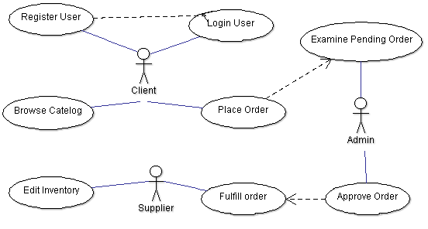
Use Case
Storefront has the main user interface in a Web front-end. Customers use the Storefront to place orders for pets
Register User
Login user
Browse catalog of products
Place order to OPC (asynchronous messaging)
Order Processing Center (OPC) receives orders from the Storefront.
Administrator
Examine pending orders
Approve or deny a pending order
Supplier
View and edit the inventory
Fulfills orders from the OPC from inventory and invoices the OPC.

Slide 37
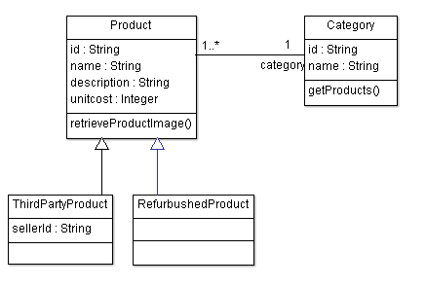
Class Notation
class name
operations
attributes
Visibility Modes : Private( - ), Protected (#) , Public (+) and Package Private()

Slide 38
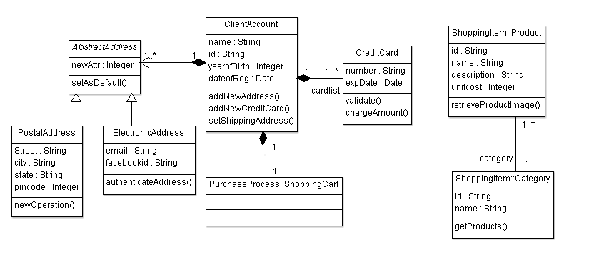
Class Relationships
Inheritance
Composition
Association

Slide 39
Different forms of association
Strongest (Composition)
Implies total ownership, if the owner is destroyed, the parts are also destroyed
Inner classes will certainly be a composition
Aggregation
Implies has-a part ownership
If the owner is destroyed, the parts still exist
Weakest (Association)
General form of dependency based on the usage of features

Slide 40
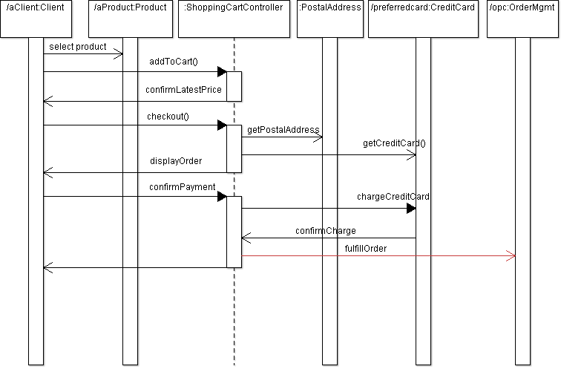
Sequence Diagrams
Sequence diagram is drawn to represent (i) objects participating in an interaction and (ii) what messages have exchanged among those objects

Slide 41
Class Responsibilities and Collaborators (CRC) Card
What
Why?
It is a physical (electronic) card
One card for one class
Indicates the responsibilities of a class
Collaboration
Sometimes a class can fulfill all its assigned responsibilities on its own
But sometimes, it needs to collaborate with other classes in order to fulfill its own responsibilities
A good technique to identify a class and its responsibility during functional architecture design
Highly collaborative and interactive process for a team of designers
The team can do it fast

Slide 42
Pattern – Three-part Schema
Pattern
Context A situation giving rise to a problem
Problem The recurring problem arising in that context
Solution A proven solution of the problem

Slide 43
Mud to Structure
Before we start a new system, we collect requirement from customer → transform those into specifications
Requirements → Architecture (Optimistic View)
“Ball of mud” is the realization
Cutting the ball along only one aspect (like along lines visible in the application domain may not be of help)
Need to consider functional and non-funcational attributes

Slide 44
Layers – 3 part schema
Context | A large system that requires decomposition
Problem | Mix of low- and high-level issues, where high-level operations rely on low-level ones A typical pattern of communication flow consists of requests moving from high level to low level, and answers to requests, incoming data and notification about events traveling in the opposite direction
Forces | Code changes should not ripple through the system Stable interfaces; standardization Exchangeable parts Grouping of responsibilities for better understandability and maintainability
Solution | Structure the system into appropriate number of layers

Slide 45
Layers
Client
Layer N
Component-N.1
Component-N.2
Component-N.3
Services of Layer J are only used by Layer J+1
No further direct dependencies between layers
Each layer may contain many components
Layer N-1
Component-(N-1).1
Component-(N-1).2
Component-(N-1).3
Layer 1
Component-1.1
Component-1.2
Component-1.3

Slide 46
Dynamics
Client receives
Client calls
Layer N
Layer N
cannot carry out the request completely on its own, it calls layer N-1
Reporting continues till the top
Layer N-1
Layer N-1
Request passing continues till Layer 1 fulfills the request
Device driver gets notification
Reports to the higher layer
Layer 1
Layer 1
Scenario - I
Scenario - II

Slide 47
Dynamics
Client calls
Layer N
Layer N
cannot carry out the request completely on its own, it calls layer below BUT….
Middle layer understands that it is a repeat request and sends the notification
Request passing does NOT continue till Layer 1.
Some Intermediate layer fulfills the req.
Layer N-k
Layer N-k
In a network protocol, lowest layer intercepts a request
Reports to the higher layer
Layer 1
Layer 1
Scenario – IV (In network protocol design, intermediate layer responds based on a notification
Scenario – III (layer of caching, where
An intermediate layer returns the data)

Slide 48
Dynamics
Scenario V
Involves two stacks communication with each other
Request received
Send request
Layer N
Layer N
Response received
Response sent
Layer N-1
Layer N-1
Layer 1
Layer 1
Send request goes through physical layer
Response message comes back through physical layer

Slide 49
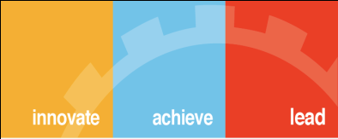
Thank You

